Slide 1
Types of Software
Software is the set of instructions that tells the hardware what to do
Two main types of software:
Operating Systems
Application Software
Productivity software
Utility software
Programming software
Applications for the Enterprise (ERP)

Slide 2
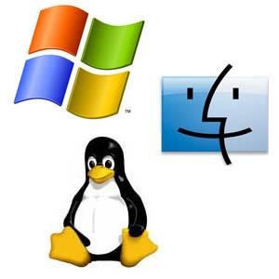
Operating Systems
All devices have an operating system
Software which manages the hardware
Creates the interface between the hardware and the user
Functions performed by the operating systems:
Managing the hardware resources of the computer
Providing the user-interface components
Providing a platform for software developers to write applications
Most popular are Microsoft Windows, Apple Mac OS, and Linux

Slide 3

History of Microsoft Windows
Source: YouTube

Slide 4
Application Software
Software that allows users to accomplish some goal or purpose
Categories:
Productivity software to help employees complete their job duties such as Microsoft Office
Utility software allows you to fix or modify your computer
For example, antivirus software
Programming software makes more software
Programmers can code, test, and convert into a format that the computer will understand
CIS students typically use Visual Studio

Slide 5

Application Software Challenges
Finding the right software to do what you need to do
How to use the right software to do what you need to do
Power Point to Death video:
You only purchase a license for the software

Slide 6
Enterprise Application Software
Early applications were often independent from other applications
Consequently, information from one application did not always correlate to information from another application
Enterprise Resource Applications (ERP) were developed to provide a common application that supports functions across the entire enterprise for the company’s employees
For example, an ERP can contain the general ledger and its subsidiary ledgers such as accounts payable, accounts receivables, etc.
Builds in best business practices for an enterprise

Slide 7

Enterprise Application Software
SAP is the most popular
Customer Relationship Management (CRM)
Manages an organization’s customers
Personalize your relationship with the customer
An example is Salesforce
Supply Chain Management (SCM) manages an organization’s
Suppliers
Manufacturing Facilities
Distributors

Slide 8
Mobile Applications
Operate on tablets and smartphones
Each device has its own operating system (e.g., Android or iOS)
Each application is developed for the specific mobile device’s operating system
Websites are now offering mobile friendly interfaces to run on mobile devices
Independent of the mobile devices’ operating system

Slide 9
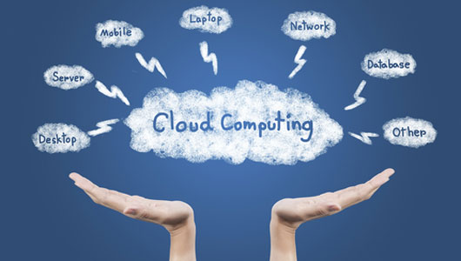
Cloud Computing
Internet-based applications, services, and data storage
Advantages:
No software to install or upgrade
If you have Internet access, you can always use it
No restrictions on how much you store and don’t have to worry about losing it
Disadvantages:
Your information is stored on someone else’s computer – how safe is it?
Internet access is required
Relying on someone else to provide these services

Slide 10
Business Cloud Usage
Private Cloud
Still uses cloud concepts but allows the business to control over that space
Improves who can access it and how it is secured
Virtualization
Using software to simulate a computer or some other device
Can create a server without actually purchasing a server

Slide 11
Software Creation
Software is written in a programming language
Consists of commands organized logically to execute specific functions
Written in human-readable format (source code) and converted to machine-readable format (object code)
Object code can be interpreted by the computer to allow interaction with the hardware
Usually done in pieces so several programmers can work together
Closed-Source Software – only object code is available for purchase
Open-Source Software:
Code is shared with everyone to use and add features or fix bugs
Examples are Firefox browser and Linux operating system

Slide 12
Open vs. Closed Source Software
Open-Source Software:
Software is available for free
Source code can be reviewed prior to installing
Large programmer groups can fix bugs and add feature
May increase risk of attack as everyone knows how your software works
Closed-Source Software:
Company that developed the software provides technical support
Employs large number of programmers to enhance the product

Slide 13

Summary
Defined the term software
Described the two primary categories of software
Described the role ERP software plays in an organization
Described cloud computing and its advantages and disadvantages for use in an organization
Defined the term open source and identify its primary characteristics

